Slide 1
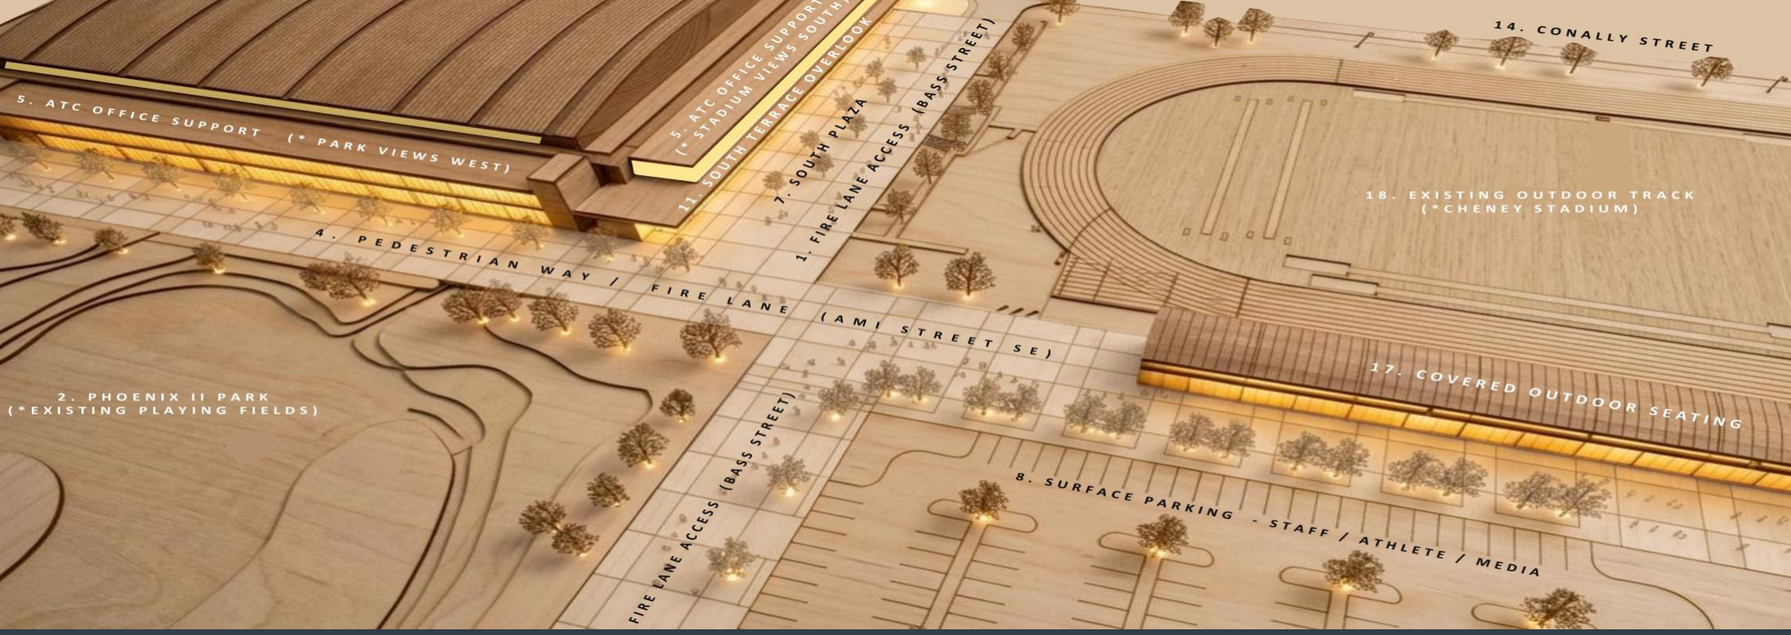

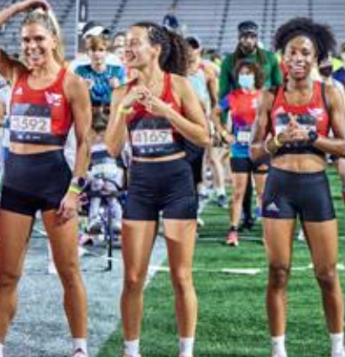
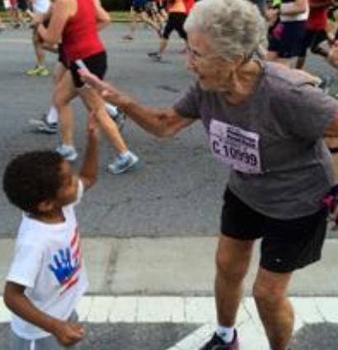
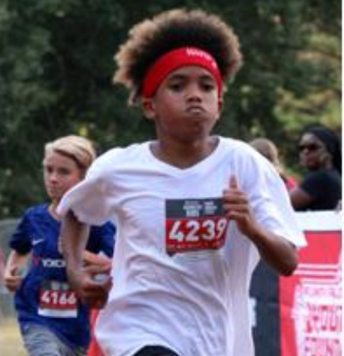
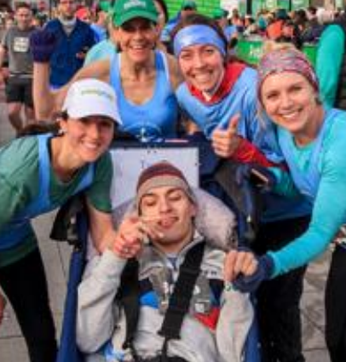
ATLANTA TRACK CLUB
TRACK & FIELD CENTER
A DEFINING MOMENT TO MAKE HEALTH AND WELLNESS ACCESSIBLE FOR ALL
SUMMERHILL COMMUNITY MEETING | JULY 6, 2026

Slide 2




A COMMUNITY PARTNERSHIP
ATLANTA TRACK CLUB
ATLANTA PUBLIC SCHOOLS
THE ORGANIZED NEIGHBORS
OF SUMMERHILL

Slide 3
EXPANSION PLANS
SUMMERHILL DEMOGRAPHICS
3,176
$59,173
An Olympic legacy facility
Growth of an Atlanta Public Schools partnership
Investment in one of Atlanta's most historic neighborhoods
Less than a mile from Grant Park, the Atlanta Zoo and the Atlanta BeltLine
Easily accessible from I-20 and I-85
Proximity to the new MARTA Rapid Transit A-Line
POPULATION
MEDIAN HH INCOME
92%
64%
WHITE COLLAR
RENTERS
RACIAL BREAKDOWN
Source: US Census Bureau, 2023

Slide 4
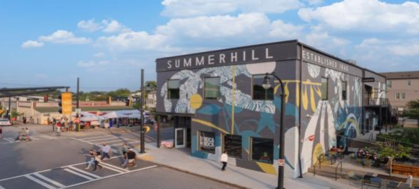
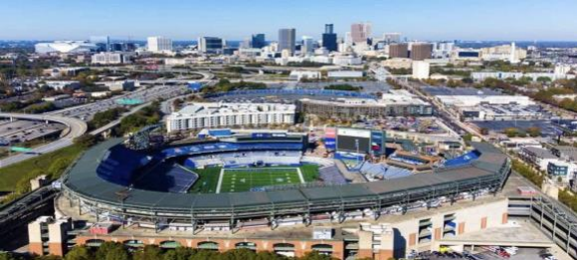
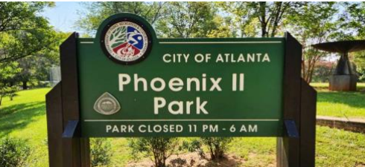
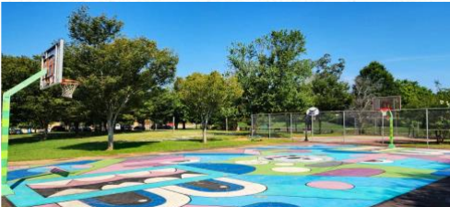
ABOUT SUMMERHILL
Summerhill is one of Atlanta’s oldest and most historically significant neighborhoods, located just southeast of Downtown Atlanta. Founded in 1865 in the aftermath of the Civil War, it emerged as a community for freed African Americans and Jewish immigrants and quickly became a thriving center of commerce, education, and civic life. By the early 20th century, Summerhill was home to churches, schools, businesses, and community leaders, including institutions that helped shape Atlanta’s Black educational history.
Like many urban neighborhoods, Summerhill experienced decades of decline as interstate construction, urban renewal projects, and large-scale stadium development disrupted the community fabric. The neighborhood faced significant population loss, vacant properties, and economic challenges through much of the second half of the 20th century. Nevertheless, residents remained deeply engaged in preserving the community’s identity, and neighborhood organizations helped lead efforts toward revitalization and reinvestment. Summerhill is also remembered for its role in Atlanta’s civil rights history and for community activism that emerged following social unrest in the 1960s.

Slide 5
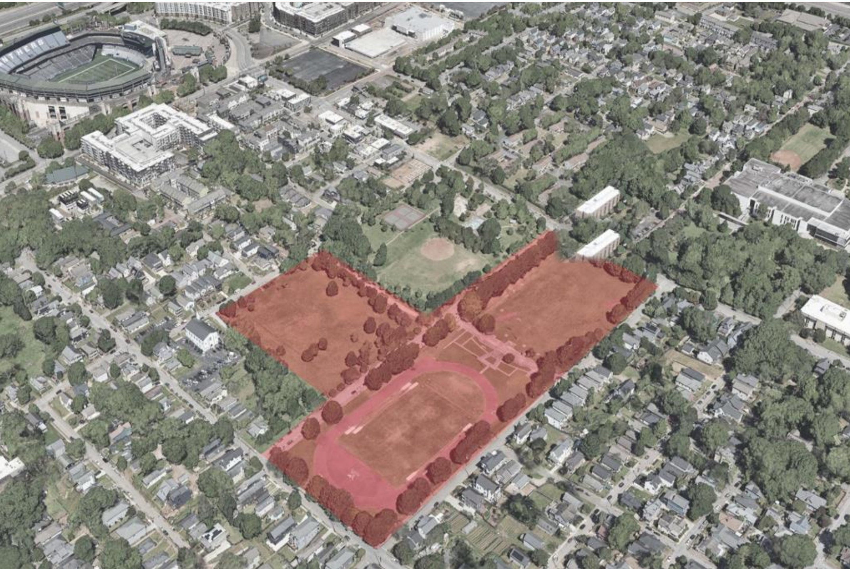
THE SITE

Slide 6
OUR COMMITMENTS
✓
Access for Atlanta Public Schools track and field, cross country, and running-related extracurricular programs, with dedicated weekly hours at the Center
✓
A running specialty retail space for a locally owned and operated business
✓
Meeting and special event space for the community
✓
At least 25% of Atlanta Track Club’s employee base from the City of Atlanta — especially Summerhill and surrounding neighborhoods
✓
A STEM and financial wellness lab built into the Center’s design, serving APS student-athletes
✓
Programmatic emphasis on surrounding neighborhoods
✓
Dedicated weekly hours for community members at City resident and non-resident-based pricing
✓
Launch of sport-specific job training programs for residents
✓
Access to health care services through a medical clinic / healthcare partnership

Slide 7
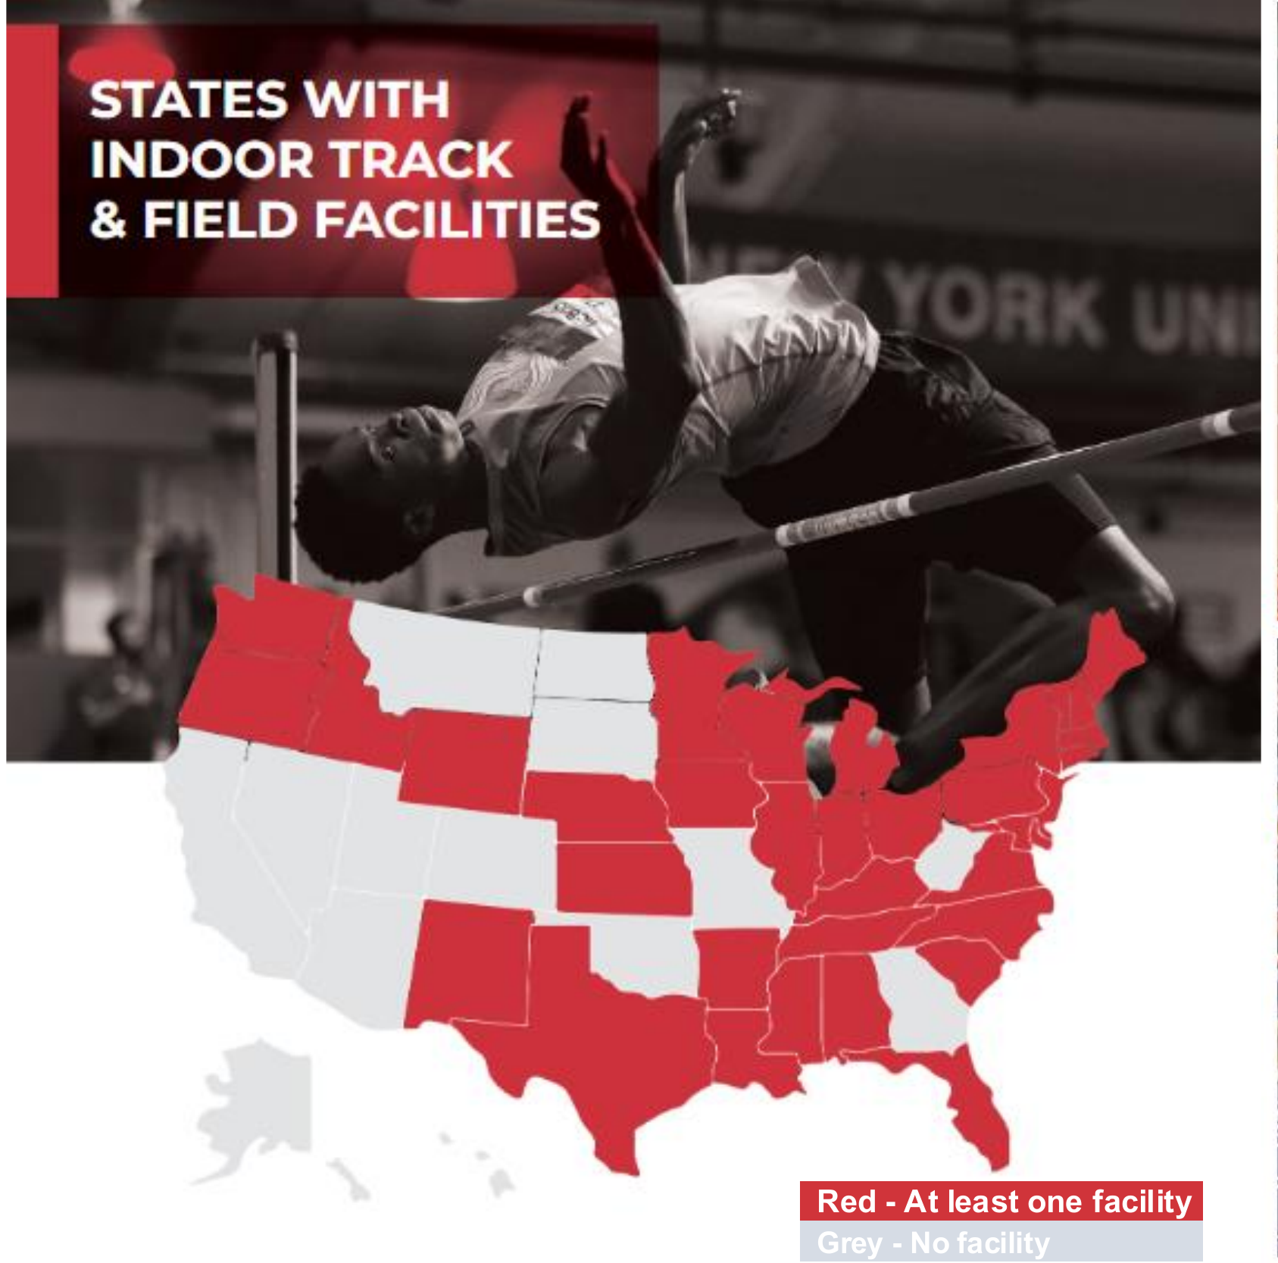
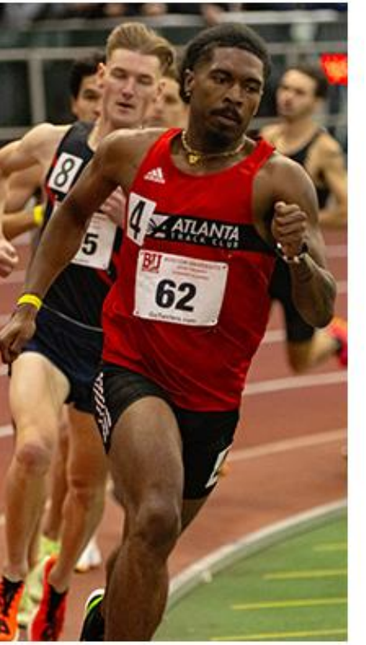
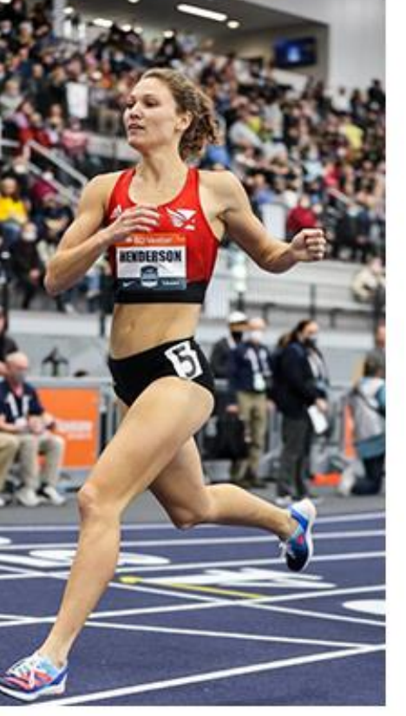
Georgia is still without a world-class indoor track & field facility.
The Track & Field Center puts Atlanta — and Summerhill — on that map.
At least one indoor facility
No indoor facility

Slide 8
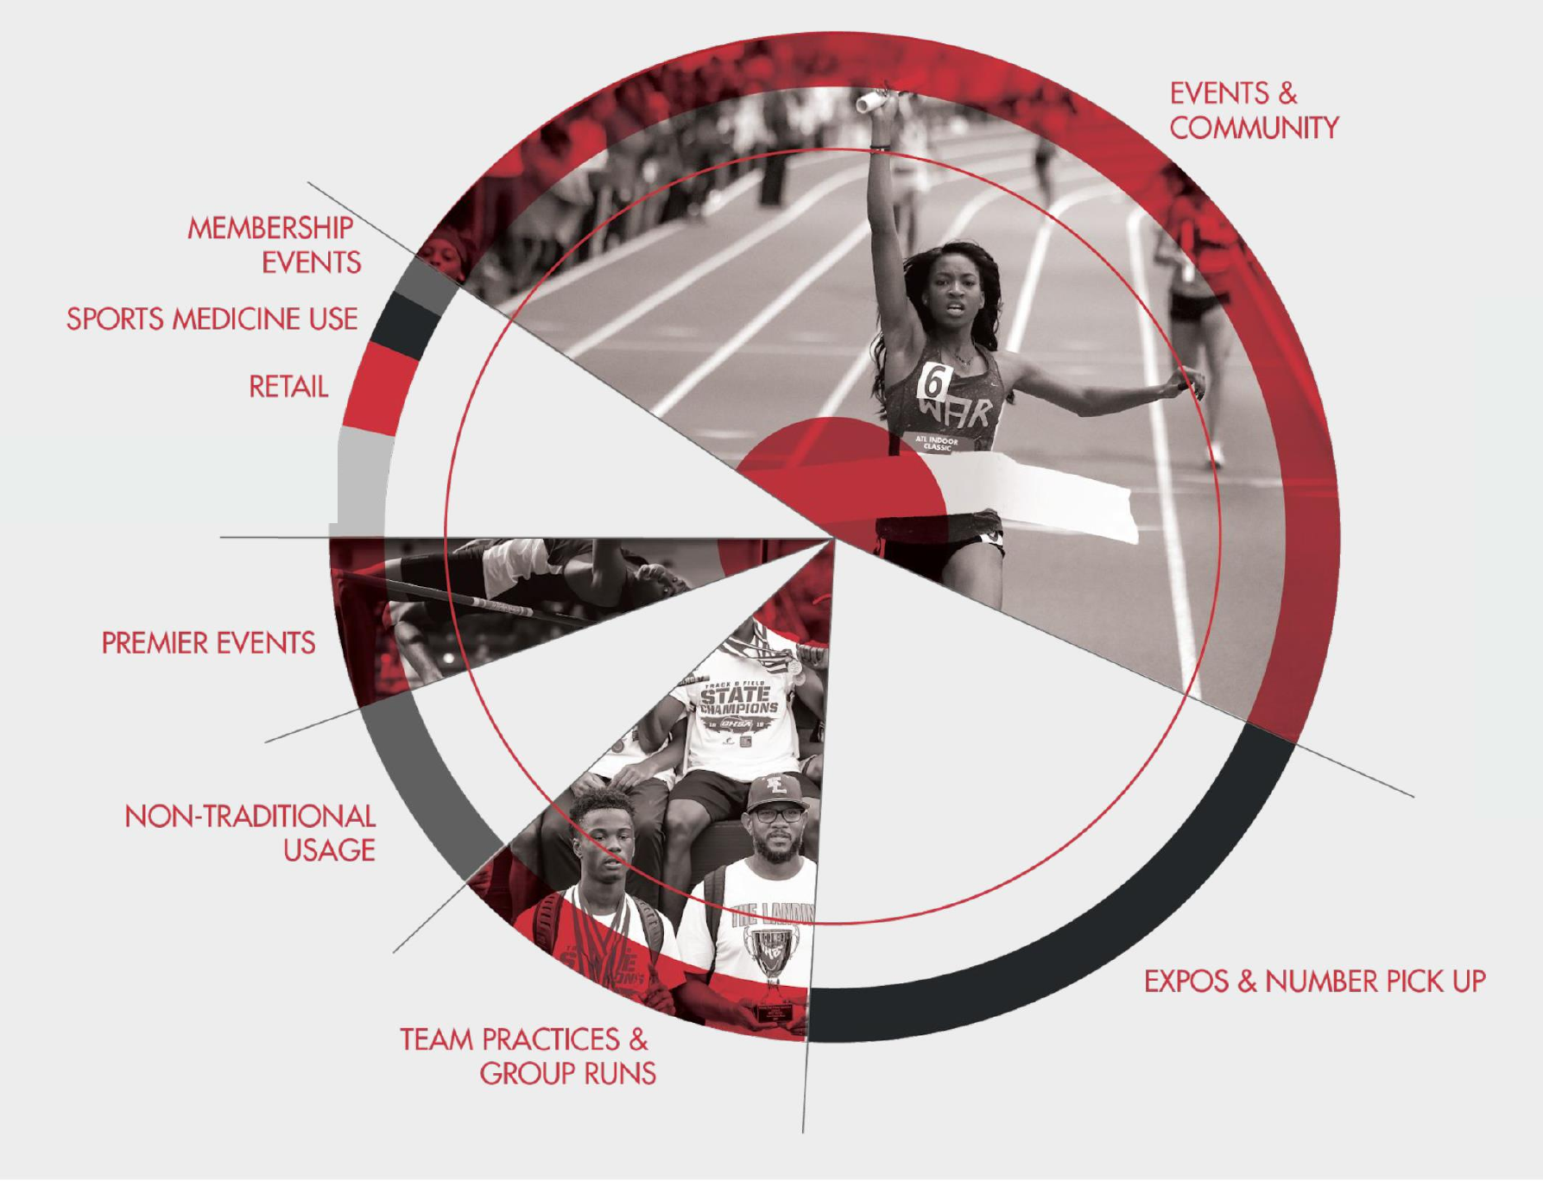
BREADTH OF PROGRAMMING & ACCESS
A Center in constant community use
GENERAL MEETINGS
& BUSINESS
From daily team practices and group runs to premier events, expos, sports medicine, retail, and community meetings — the Center is programmed for the neighborhood year-round.

Slide 9
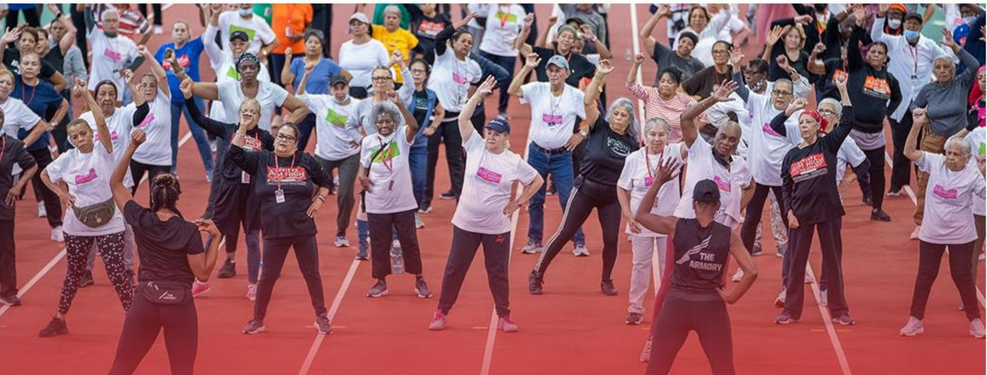
COMMUNITY & ACCESSIBILITY
An ever-present open door
Contemplated Hours Per Week | Outdoor Track | Indoor Track | Fitness & Weight Room | STEM Center | Meeting Space
Community Hours | 100 | 30 | 30 | 20 | 30

Slide 10
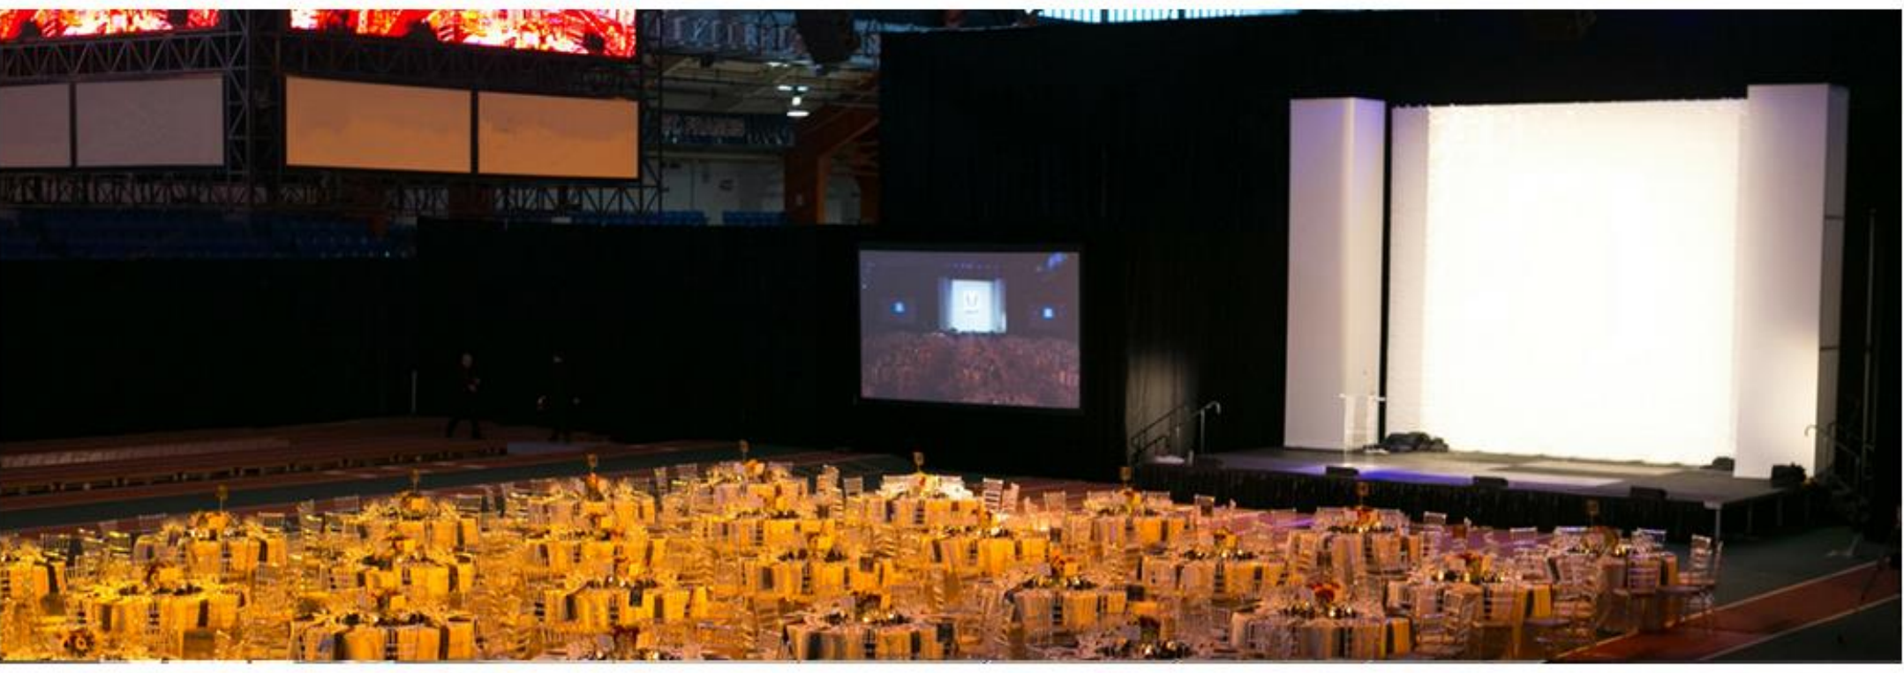
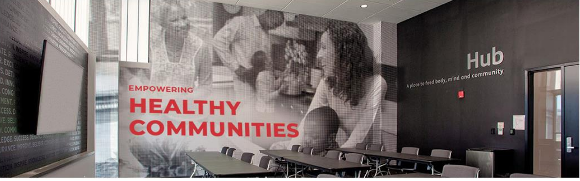
COMMUNITY EVENT SPACE

Slide 11


REGIONAL, NATIONAL & INTERNATIONAL EVENTS & PROGRAMS
With a Center capacity of up to 3,250, Atlanta Track Club will host best-in-class youth, high school, collegiate and professional competitions. Atlanta will become known as THE destination for indoor track and field and running at all levels.
Events to Host
Junior Olympics
GHSA State Championships
High School National Championships
UAA Championships
ACC Championships
SEC Championships
ASUN Championships
NCAA Div I, II & III Championships
USATF National Championships
World Athletics Championships

Slide 12

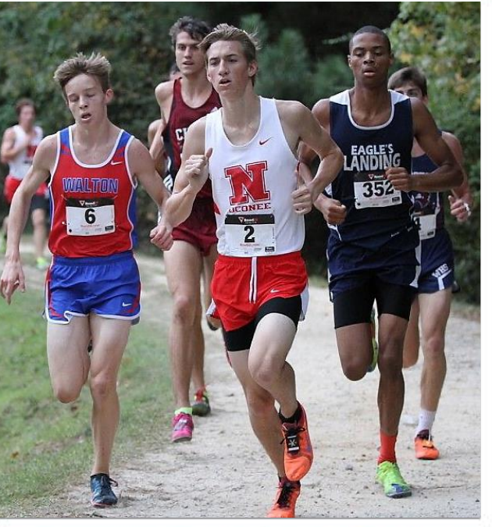

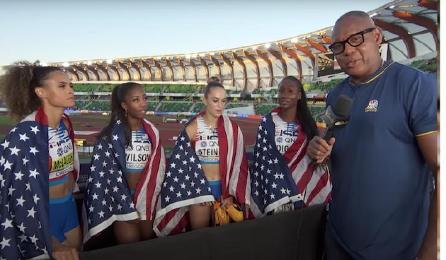
SPORTS BROADCAST PARTNERSHIPS
Events and programs hosted at the Track & Field Center will be featured on ESPN (NCAA Championships), NBC (USA Championships) and MileSplit (HS Championships). All smaller events will be webcast in-house through a content-sharing partnership with The Atlanta Journal-Constitution, with a goal of every lap at every event easily viewed LIVE and on demand on the AJC’s website in a branded media player.

Slide 13
BEST-IN-CLASS OFFERINGS
 | Track Club Center | Reggie Lewis Center Boston | Armory New York | New Balance Indoor Center | YMCA | Lifetime Fitness
Free public schools access | ✓ | ✓ | Paid only | Paid only
Free access to neighborhood seniors | ✓
Neighborhood or income-based pricing | ✓ | ✓ |  |  | ✓
Hydraulic oval | ✓ |  |  | ✓
Court sports | ✓ | ✓ |  |  | ✓ | ✓
Running retailer & QSR | ✓ |  | ✓ | ✓
Health care offerings | ✓
Public meeting space | ✓ | ✓ | ✓ |  | ✓
STEM center | ✓ |  | ✓
Neighborhood employment & training programs | ✓ | ✓ |  |  | ✓

Slide 14
ADDENDUM
Project timeline, tax & economic impact

Slide 15
PROJECT TIMELINE
24-MONTH CAPITAL RAISE
July
2026
September
2027
July
2028
September
2029
24-MONTH CONSTRUCTION

Slide 16
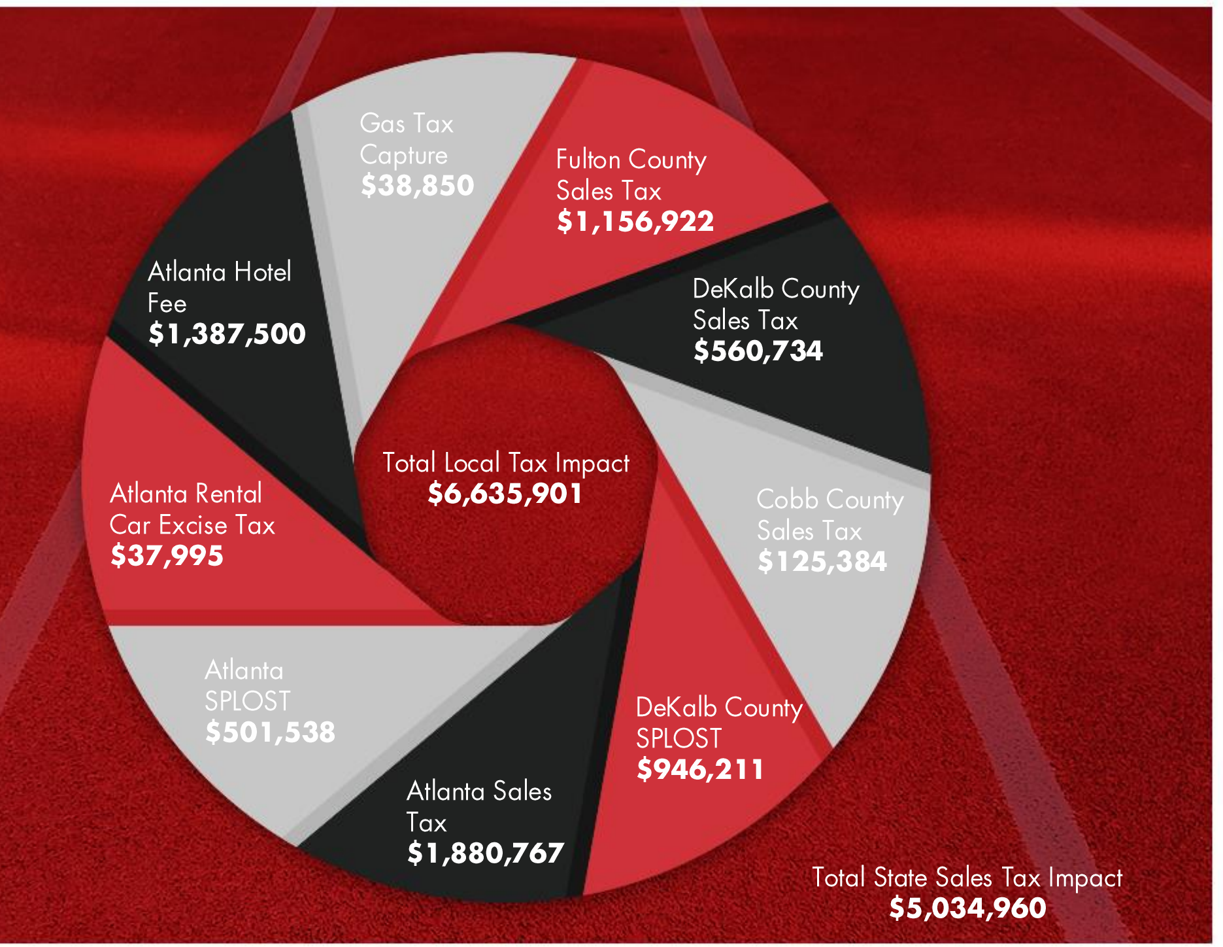
ANNUAL TAX IMPACT ON REGION

Slide 17
ANNUAL ECONOMIC IMPACT
Atlanta Track Club commissioned an independent economic impact study, which has been reviewed and endorsed by the Metro Area Chamber of Commerce.

Slide 18
THANK YOU, SUMMERHILL
Questions & Discussion
Atlanta Track Club Track & Field Center | Summerhill Community Meeting | July 6, 2026

